Slide 1
Typing Speed Test Application
Typing Speed Test
00:30
The quick brown fox jumps over the lazy dog.
A Python-Based Mini Project
The quick brown fo|
Presented by: Darshan Jadav (12402080601024)
Class/Branch: IT - A
Subject: Python Programming
Guided by: Nayan Mali
Notes:
Introduce the project title, team members, class and guide. Mention that this is a Python mini project that measures typing speed and accuracy.

Slide 2
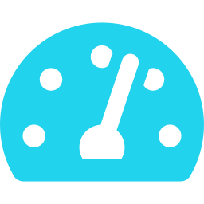

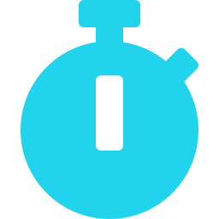

Introduction
A typing speed test application measures how fast and how accurately a user types a given text.
Typing Speed Test
00:30
Type this text:
Measures typing speed in Words Per Minute (WPM)
The quick brown fox jumps over the lazy dog.
Evaluates typing accuracy
Your input:
Displays the time taken to type a given text
The quick brown fo|
Helps users improve typing skills through practice
Press Enter when finished
Illustrative interface mockup
Notes:
Define a typing speed test: the user types a given passage while the program measures speed (WPM), accuracy and time taken. Regular use helps improve typing skills.

Slide 3

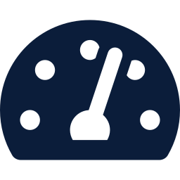



Problem Statement and Objectives
PROBLEM STATEMENT
Users need a simple way to measure and improve their typing speed and accuracy.
Objectives
01
02
03
04
Calculate typing speed in WPM
Measure typing accuracy
Provide a simple and user-friendly interface
Encourage regular typing practice
Notes:
State the problem clearly, then walk through the four objectives: speed, accuracy, simple interface, regular practice.

Slide 4





Technologies Used
Tkinter (optional)
Graphical user interface, if used in the project
Legend
Core Python
String processing
Compares typed text with the given text
Basic calculations
Compute WPM and accuracy
Optional
Core items use only built-in Python. Tkinter is needed only for the GUI version.
time module
Tracks test duration
Python
Main programming language
Notes:
Python is the base. The time module tracks duration. String processing and basic calculations give WPM and accuracy. Tkinter is optional and only used if the project has a GUI.

Slide 5

Features of the Application
Displays a sample passage for typing
Results Dashboard
Example values
Starts and tracks the typing timer
35
92%
60s
Calculates typing speed in WPM
WPM
Accuracy
Time
Calculates typing accuracy as a percentage
Accuracy
Displays final results after typing
Try Again
Provides a restart or retry option, if implemented
Illustrative dashboard mockup
Notes:
Walk through the features top to bottom. The dashboard values are examples only, not measured results. Retry is mentioned only if it is implemented in your project.

Slide 6

Working Methodology and Algorithm
1
2
3
TYPING SPEED
WPM = (Number of characters typed ÷ 5) ÷ Time in minutes
Launch the application
Display the sample passage
Start the timer when typing begins
ACCURACY
Accuracy (%) = (Correctly typed characters ÷ Total characters typed) × 100
6
5
4
Display the final results
Calculate elapsed time, WPM and accuracy
Capture the user's typed input
Handle empty input and zero elapsed time safely to avoid division by zero.
Notes:
Follow the arrows: 1 to 6. WPM uses the standard convention of 5 characters per word. Accuracy is the share of typed characters that match the passage. Always guard against empty input and zero time.

Slide 7
Implementation and Sample Output
Key logic
import time
passage = "Practice makes perfect."
start = time.time()
typed = input("Type the passage: ")
end = time.time()
elapsed = end - start
minutes = elapsed / 60
if typed and minutes > 0:
wpm = (len(typed) / 5) / minutes
pairs = zip(typed, passage)
correct = sum(a == b for a, b in pairs)
accuracy = correct / len(typed) * 100
else:
wpm, accuracy = 0, 0
print(f"Typing Speed: {wpm:.0f} WPM")
print(f"Accuracy: {accuracy:.0f}%")
print(f"Time Taken: {elapsed:.0f} seconds")
Capture the user's input
Record start and end times
Calculate elapsed time
Compare typed and original text
Calculate and display WPM and accuracy
EXAMPLE OUTPUT (illustrative, not measured)
Typing Speed: 35 WPM
Accuracy: 92%
Time Taken: 60 seconds
Notes:
Explain the code top to bottom: record start, capture input, record end, compute elapsed time, then WPM and accuracy. The output shown is an example only; replace it with your own real run if you want to show actual results.

Slide 8





Conclusion and Future Scope
Conclusion
Future Improvements
Provides a simple method to evaluate typing speed and accuracy
Demonstrates Python programming, time measurement, string processing, and basic calculations
Multiple difficulty levels
Personal best scores and progress history
User profiles and leaderboards
Multilingual typing tests
Improved graphical interface
Thank You — Questions?
Q
&
A
Enter
Notes:
Summarise what the project demonstrates, mention two or three future improvements, then invite questions.

